Slide 1
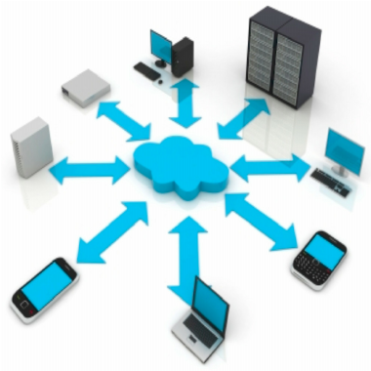
Home Appliance data on cloud
Under supervision of Dr. Brijesh Kumar Chaurasia

Slide 2
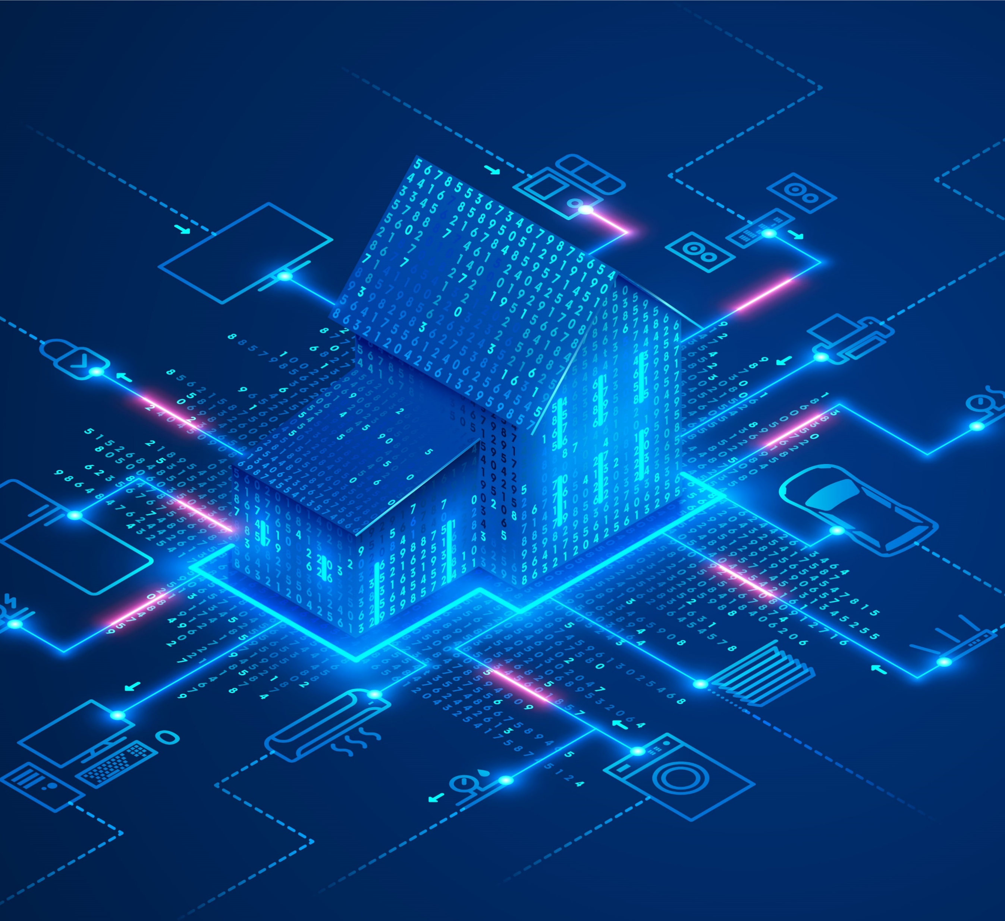
2. Introduction
Technologies for Internet of Things (IoT) such as sensor, network and data processing are advancing rapidly.
To design a platform to connect sensor data with users daily life. By implementing home appliances monitoring and controlling system.
Current products always have platform compatibility problems, additionally, user interaction in such systems are becoming more and more complex.
To enhance old appliances and the controlling experience.
The sensor data is collected by a microcontroller and then sent to our server using WI-Fi, which can be then processed and displayed on our website.

Slide 3
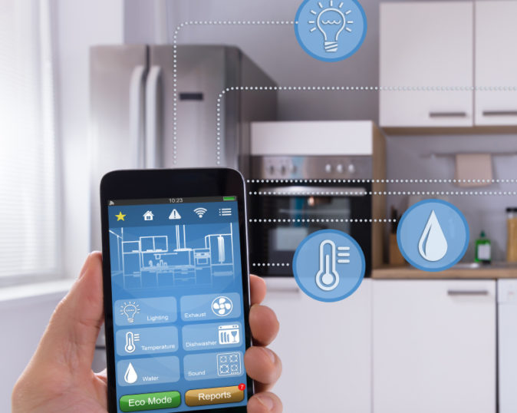
3. Motivation of the Work
Smart home has been a dream for both utilities and consumers for a long time, such implementations are still very rare.
On the opposite side, there are lots of existing commercial solutions and advanced Demand side Management (DSM) systems targeted on giant industrial consumers.
Almost all of them fail to integrate small residential consumers.
The main goal of this project is to provide that smart home experience to the residential consumers with the advance monitoring (IoT based) systems along with the ease of simple interfaces on a single platform.

Slide 4
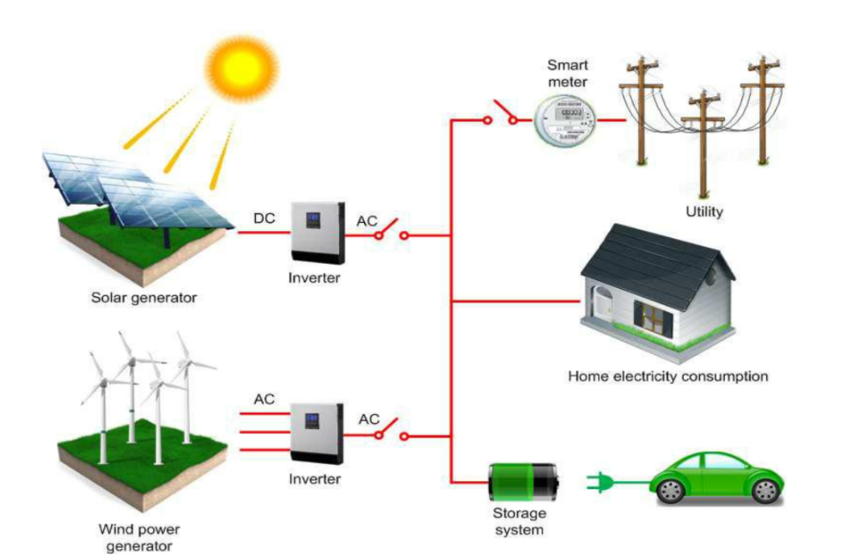
4. State-of-The-Art Techniques/Works
Novel architectures in terms of software technologies with focus on domestic environmentsand habitat monitoring are proposed in (Monacchi et al., 2013) . In (Monacchi et al., 2013) the authors promote design guidelines for collecting and integrating household data, thus enabling data interoperability.

Slide 5
4. State-of-The-Art Techniques/Works
Authors of (Kamilaris et al., 2011) propose a solution for a Web-based energy-aware smart home framework that enables smart appliances to the Web. They have developed a graphical user interface to ease the interaction. The evaluation of their solution is done using a WSN organized in a star topology

Slide 6
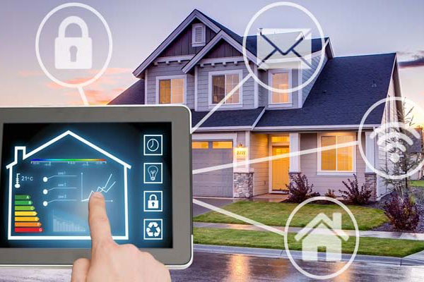
4. State-of-The-Art Techniques/Works
VillaSmart (Caracaş et al., 2013) is associated with the ECOGRID EU (EcoGridEU, 2015) project. The authors have installed a modular and extensible WSN in a test and reference household called VILLASMART.

Slide 7
4. State-of-The-Art Techniques/Works
In (Lee and Lee, 2015), they suggest a four-layer architecture made up of: sensing, networking, service and interface. The role of the cloud is missing; therefore, it is not clear how services would be enabled.

Slide 8
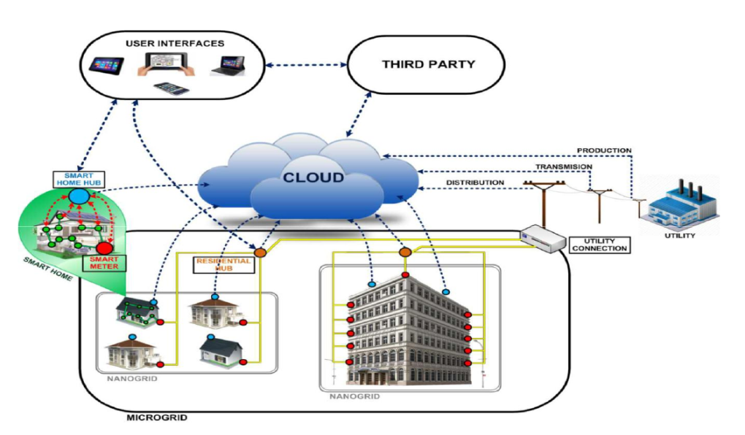
4. State-of-The-Art Techniques/Works
In literature (Da Xu et al., 2014) we can see the model is augmented with the cloud in the middle, This multi-level stratified holistic framework supported internet of Things is employed as a wrapper or generalization of all the key features of IoT solutions for smart homes known in the literature.

Slide 9
5. Problem Observed on the State-of-The-Art Techniques/Works
Big-Data The IoT- generated data come in big amounts, are variable in terms of structure, often arrive at real-time. This volume, velocity and variety make the storing and analytics solution, which will generate useful insights, a very complex one. Traditional SQL-queried relational database management systems (RDBMSs) are unsuitable for the task, which is why big data solutions are needed. A constellation of tools has evolved to service the market, most notably Apache's open-source Hadoop distributed data processing system, plus various NoSQL databases and a range of business intelligence platforms

Slide 10
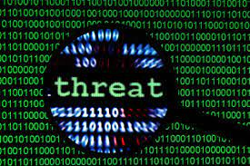
5. Problem Observed on the State-of-The-Art Techniques/Works
Security Because of the way in which data is transmitted, IoT is inherently vulnerable to most of the common attacks of wireless networks. Hence, IoT requires a security policy. Different approaches that provide security lightweight crypto-primitives should be investigated in order to provide authenticity, integrity and confidentiality

Slide 11
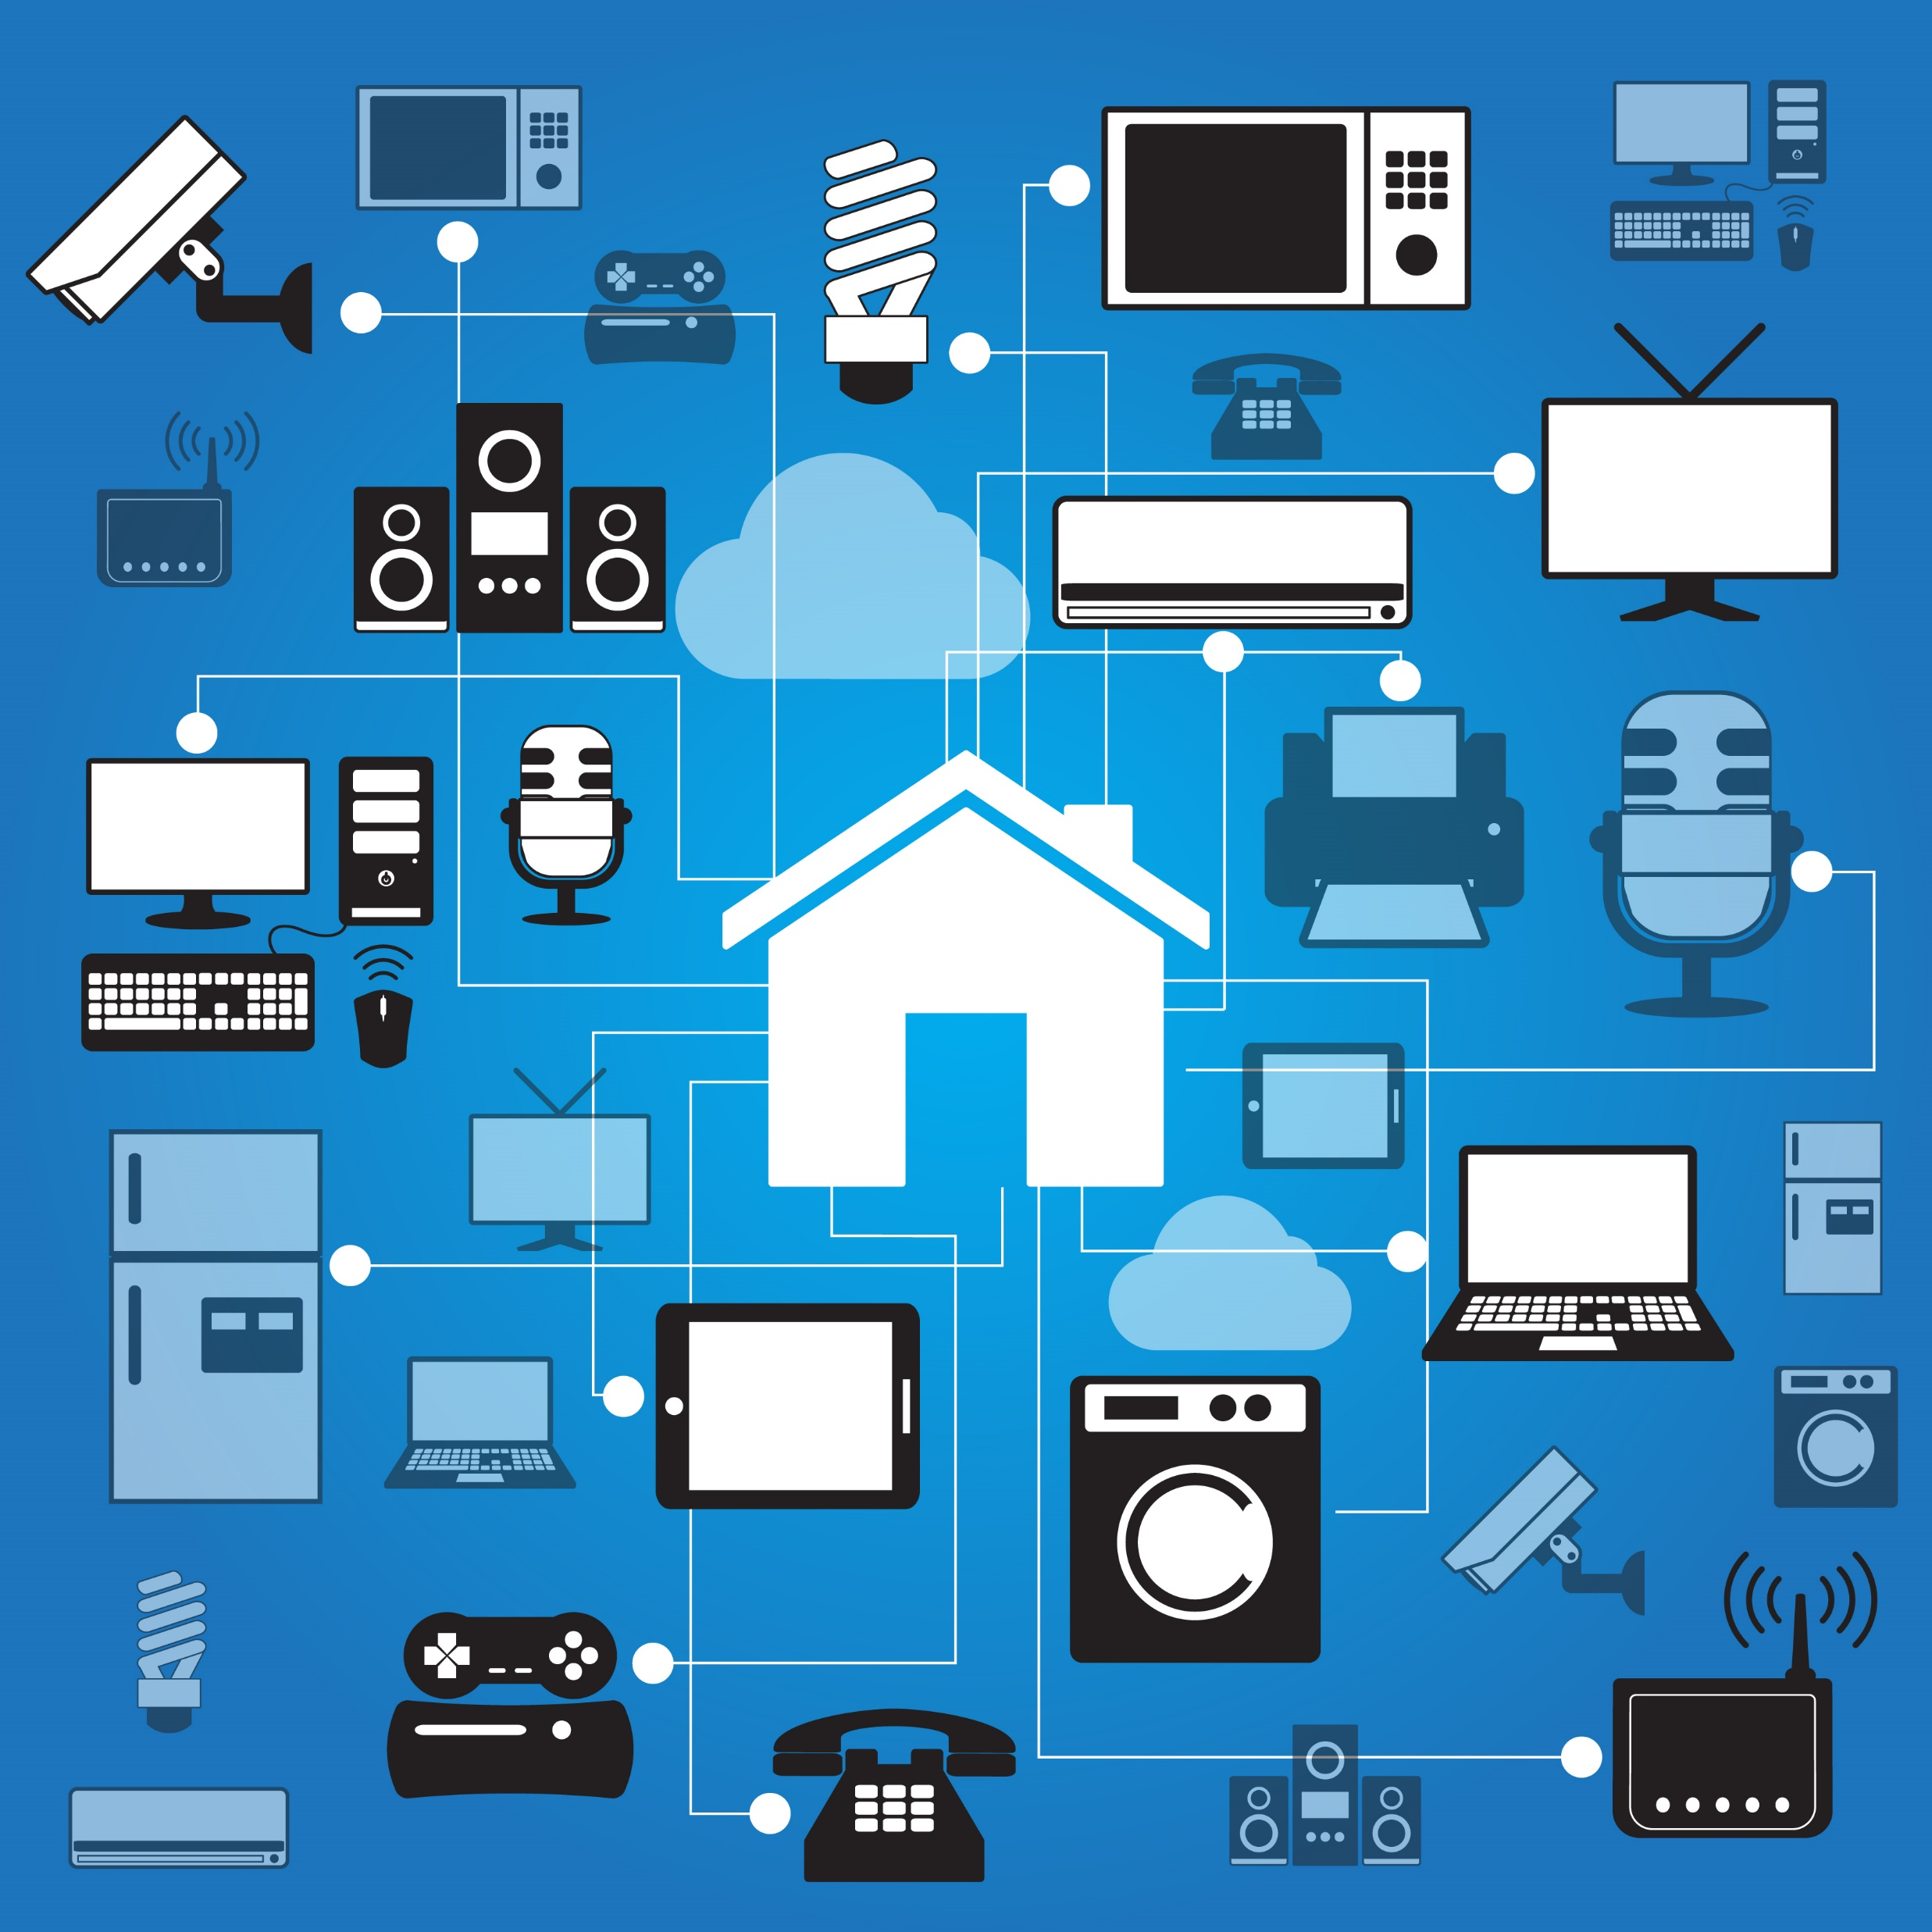
5. Problem Observed on the State-of-The-Art Techniques/Works
Lack of unifying platform There is a lack of a unifying platform that would transform these separate individual applications into a single infrastructure, a platform that can be further used for advanced data mining and knowledge extraction. The desired solution should aggregate all available smart home data within a self-learning engine in order to create personalized recommendations for all users, regardless of the level of automation present at their homes.

Slide 12
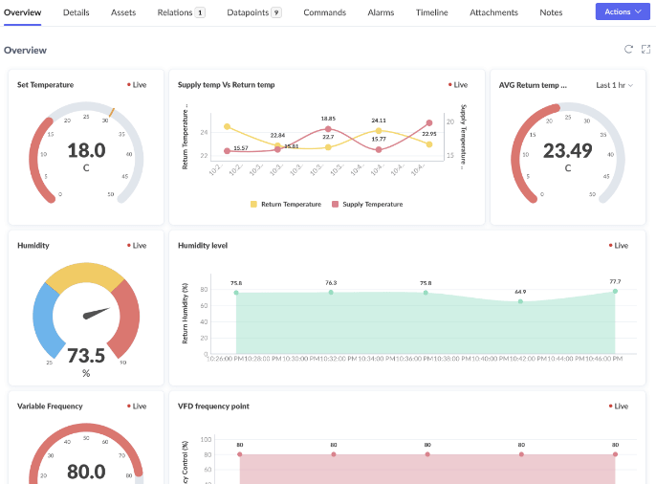
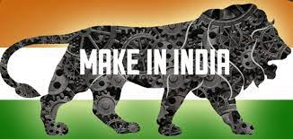
6. Exact Problem you are going to solve
Required a unified platform
Energy consumption management
Devices already in market are managed by Chinese companies such as Tuya which have access to all of our activities.

Slide 13
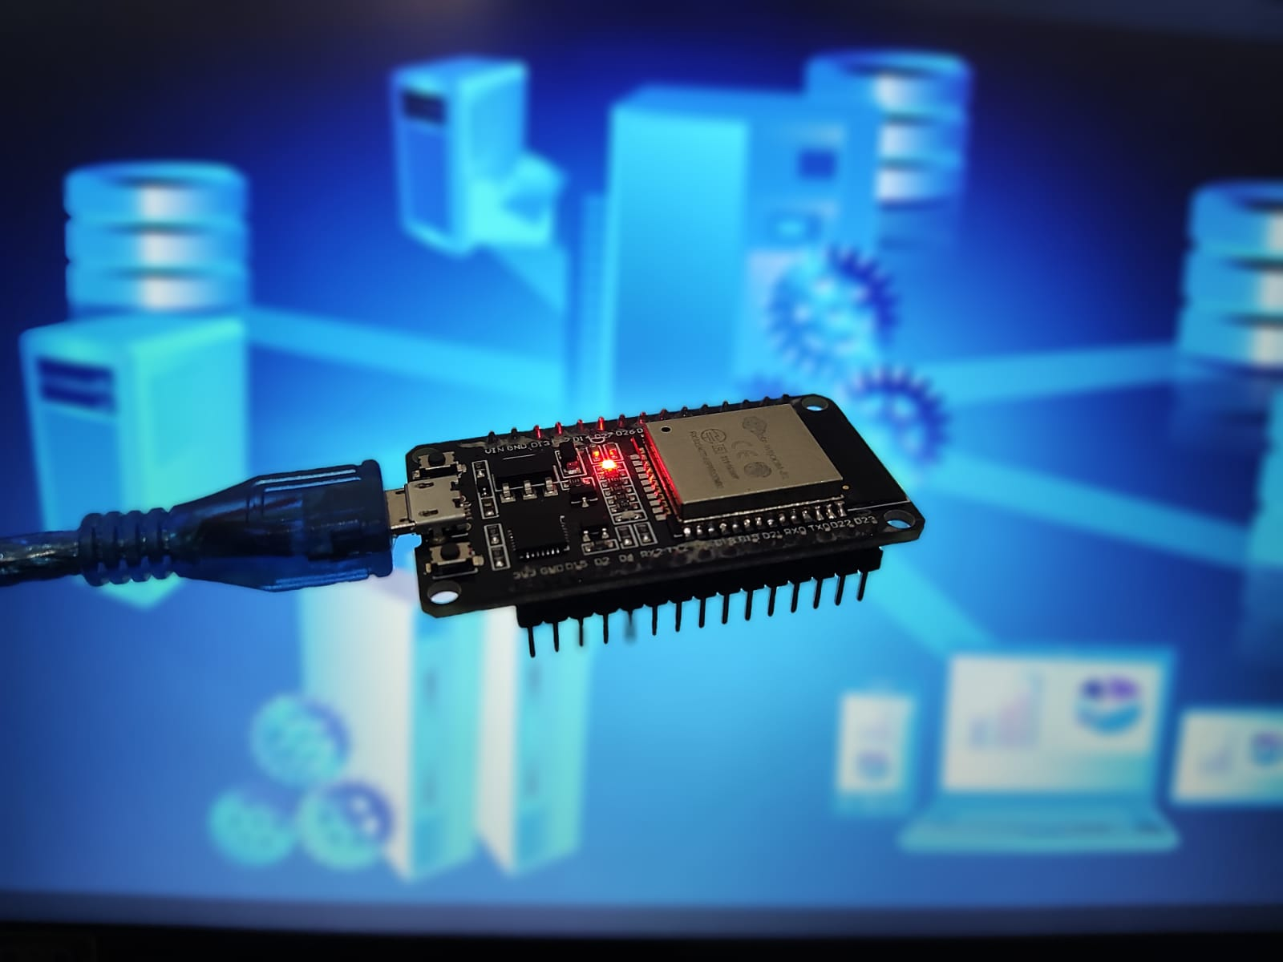
7. Novelty of the Work
Cloud based platform for all IoT devices
Electricity monitoring of each device using sensors to detect on/off timings as well as power consumptions.

Slide 14
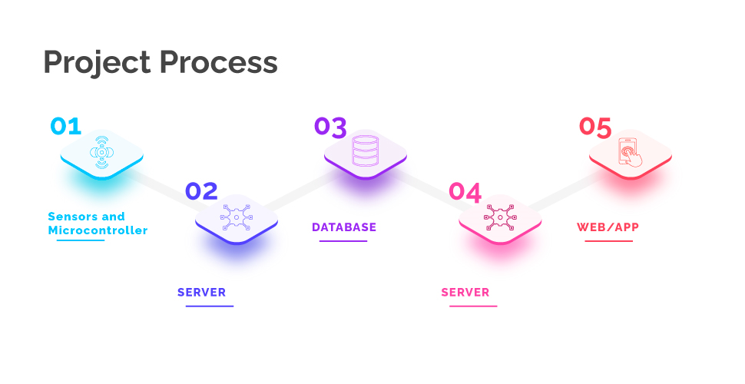
8. Proposed methodology
The simple method we are proposing in-order to make our devices smart by collecting their data through sensors then sending them to our data bases using internet and then displaying it on our web pages or applications

Slide 15



8. Proposed methodology
Technology used
Frontend: React JS, Javascript, CSS, Flutter, Material UI, Axios
Backend: Node JS, MongoDB Atlas
Hardware Programming: C on Arduino IDE

Slide 16
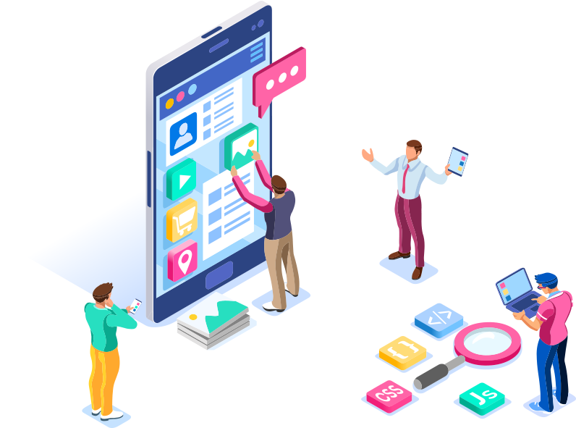
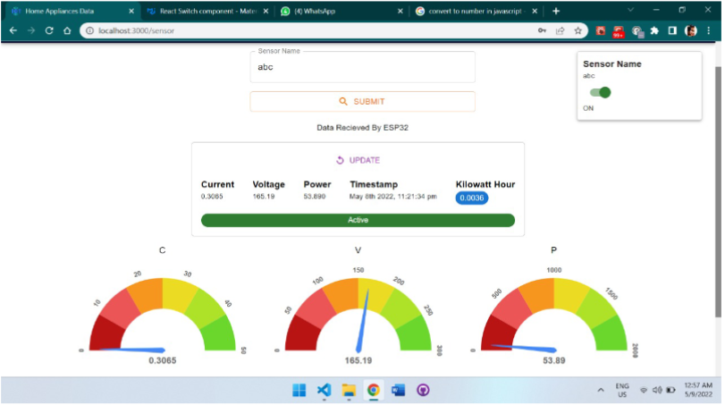
9. Results and outcomes
We are able to see the live recent current and voltage consumption values on our web and mobile applications
We can successfully control the state(ON/OFF) of the appliance through our app
We are storing number of units that are consumed by the appliance safely on our cloud database

Slide 17
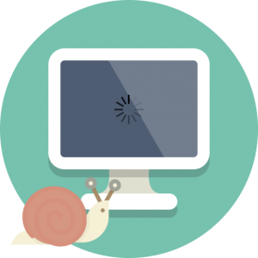
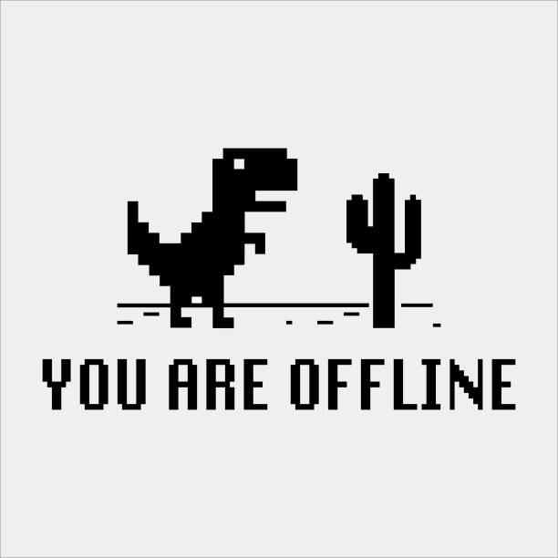
10. Limitations
The servers used in our project are the free ones so there is a slight delay of seconds while changing the state(ON/OFF) of the appliance
The wifi settings is hard coded into the microcontroller, so if it goes out then there is now way to control the device but the reading will be taken and sent to the server when the internet is back

Slide 18
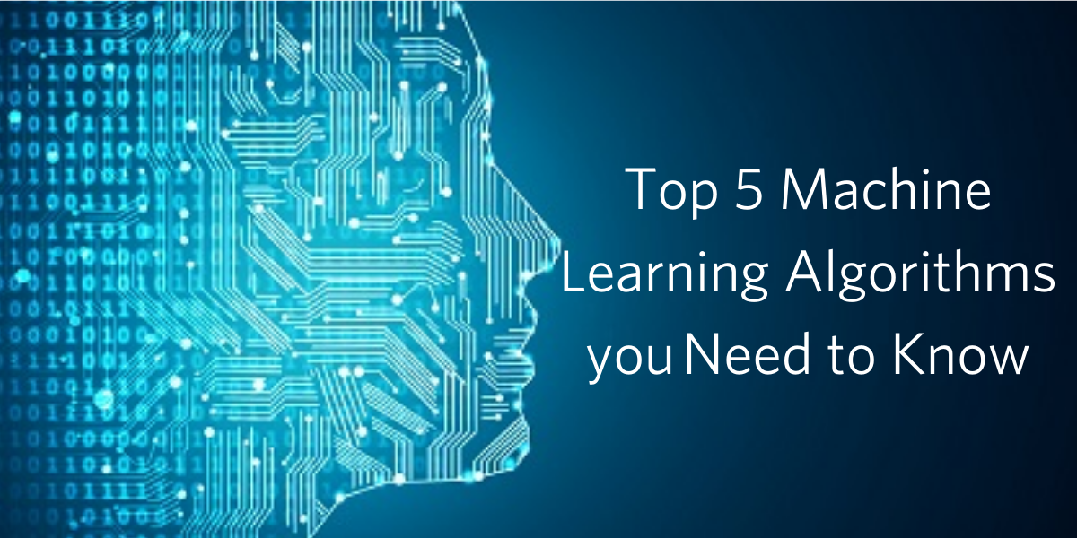
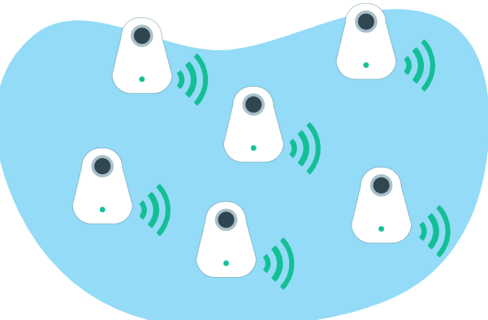
11. Future Research Plan
In the future we would like to apply various different algorithms of machine learning on the data collected to make it useful for the consumers.
We would like to test our project for multiple devices like a network of devices.
We will use different types of sensors for different appliances as needed

Slide 19
12. Conclusion
In our project we tried to overcome the problems in making the home appliances smart and collected their electricity consumption data on our data base and then we displayed that data on out webpage/application from where we can also control the status of the device. We learned many things through this project like the use of microcontrollers and sensors which was a worthy experience and also we learnt the importance of team work and we helped each other in their contributions.

Slide 20
10. References
Monacchi, A., Egarter, D., Elmenreich, W., 2013. Integrating households into the smart grid, Modeling and Simulation of Cyber-Physical Energy Systems (MSCPES), 2013 Workshop on. IEEE.
Kamilaris, A., Trifa, V., Pitsillides, A., 2011. HomeWeb: An application framework for Web-based smart homes, Telecommunications (ICT), 2011 18th International Conference on. IEEE.
Caracaş, A., Mueller, F.L., Sundström, O., Binding, C., Ja nsen, B., 2013. VillaSmart: wireless sensors for system identification in domestic buildings, IEEE PES ISGT Europe 2013. IEEE.
Lee, I., Lee, K., 2015. The Internet of Things (IoT): Applications, investments, and challenges for enterprises. Business Horizons 58.
Dobre, C., Xhafa, F., 2014. Intelligent services for big data science. Future Generation Computer Systems 37,

